Slide 1
Work Progress
By: Abdur Rehman

Slide 2
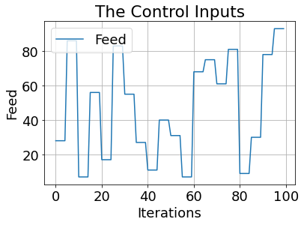
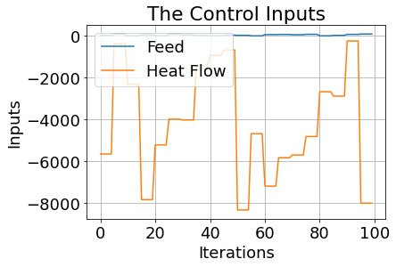
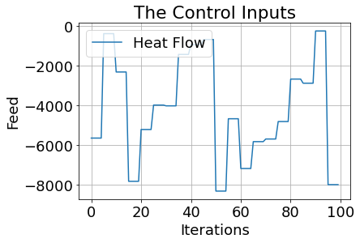

Visualizing the Inputs and Outputs
The control inputs are the feed F and the heat flow$\dot{ Q }$:

Slide 3
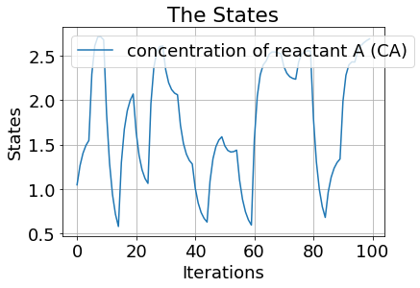
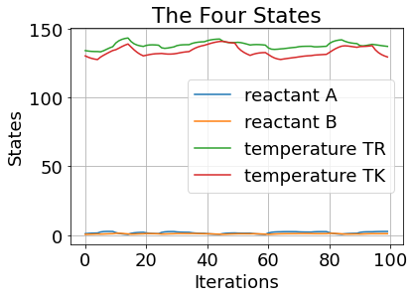
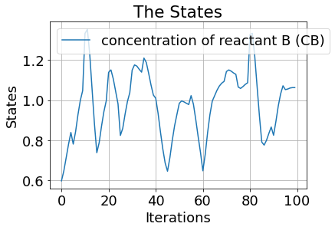
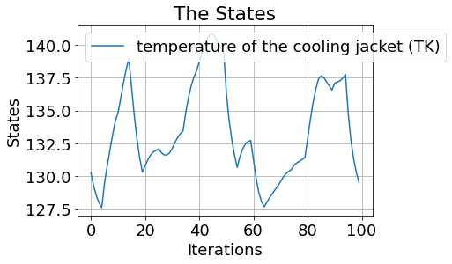
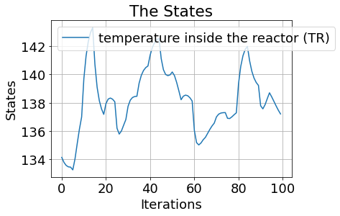
The four states are concentration of reactant A (CA), the concentration of reactant B (CB), the temperature inside the reactor (TR) and the temperature of the cooling jacket (TK):

Slide 4
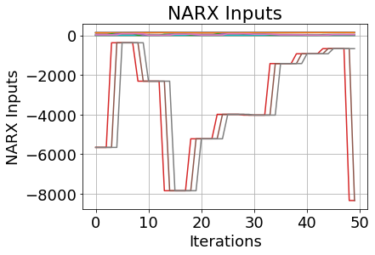
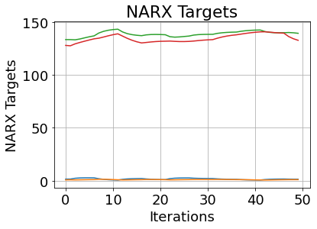

The First NARX Concatenation
nU_delay = int(3)
nY_delay = int(3)
Inputs:
inputs.shape : (3597, 18)
print(inputs):
Targets:
print(targets.shape): (3597, 4)
print(targets):

Slide 5
Keras-Tuner: Hyperparameter Optimization Framework
Tune The Model Architecture:
The first thing we need to do is writing a function, which returns a compiled Keras model. It takes an argument hp for defining the hyperparameters while building the model.
The parameters expected to be tuned:
Number Of Hidden Layers
range(hp.Int('hidden_layers', 2, 20))
Number Of Neurons
units=hp.Int('units_nodes_' + str(i), min_value=32, max_value=512, step=32)
Activation Functions
activation=hp.Choice('activation_' + str(i), ["relu", "tanh", "sigmoid"]))
Learning Rate
hp.Float('learning_rate', min_value=1e-4, max_value=1e-2, sampling="log")
Optimizers Used ADAM:
optimizer=tf.keras.optimizers.Adam
Metrices Considered:
metrics=['mean_squared_error', 'mean_absolute_error', 'mean_absolute_percentage_error', 'cosine_proximity’, tf.keras.metrics.RootMeanSquaredError()]
Loss: 'mean_absolute_error'

Slide 6
Results 1:
tuner.results_summary() :
Best mean_absolute_error So Far: 67.2745376586914
Total elapsed time: 00h 06m 29s
Best Tuning Parameters:
History Test
cosine_proximity
loss | 67.1805191040039
mean_absolute_error | 67.1805191040039
mean_absolute_percentage_error | 499.7796325683594
mean_squared_error | 7677.29541015625
History Train
cosine_proximity | 1.4289933443069458
loss | 67.2745590209961
mean_absolute_error | 67.2745590209961
mean_absolute_percentage_error | 492.40216064453125
mean_squared_error | 7705.07421875

Slide 8
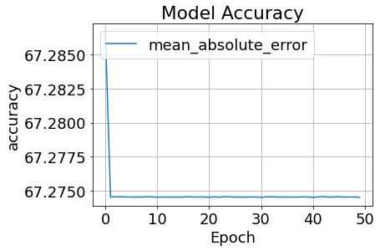
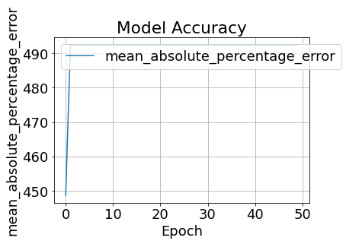
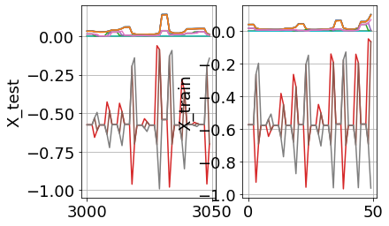
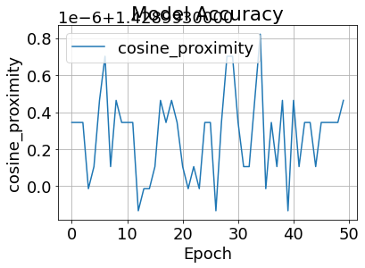
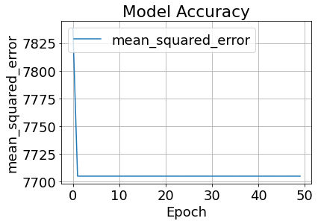
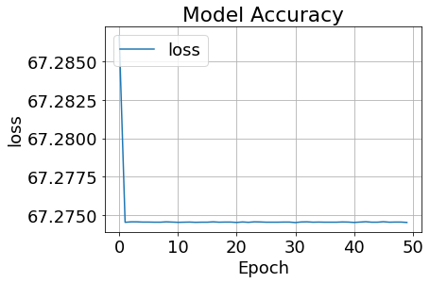
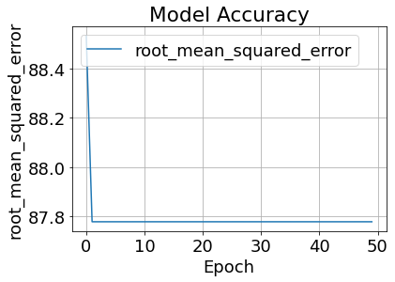

Slide 9
CHANGE OF NARX MODEL NUMBER 2

Slide 10
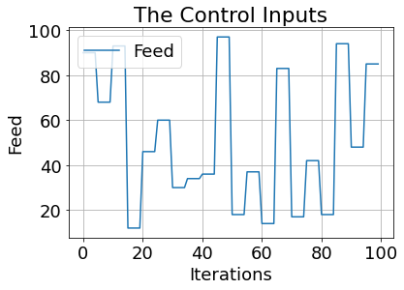
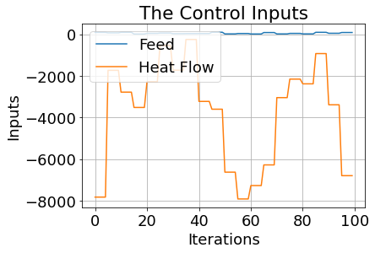
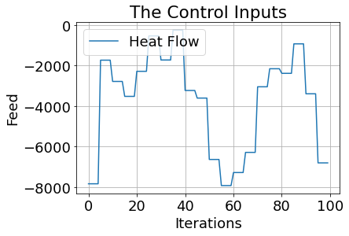
The control inputs are the feed F and the heat flow$\dot{ Q }$:

Slide 11
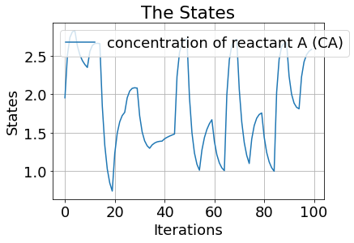
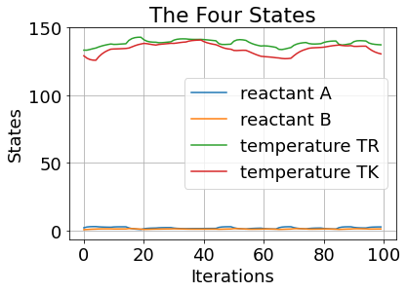
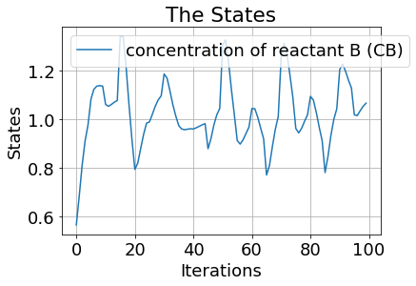
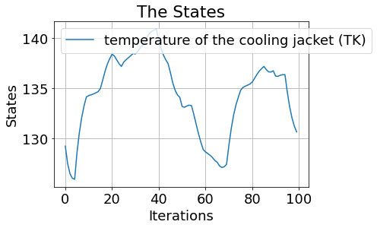
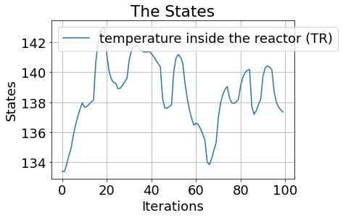
The four states are concentration of reactant A (CA), the concentration of reactant B (CB), the temperature inside the reactor (TR) and the temperature of the cooling jacket (TK):

Slide 12
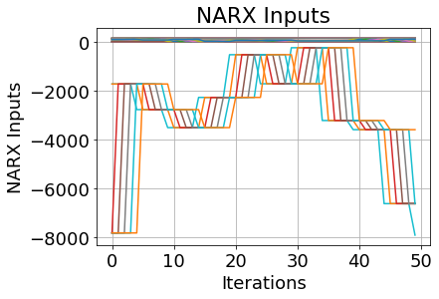
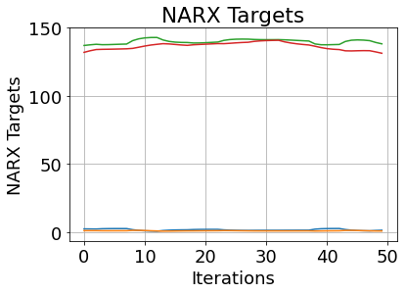
The First NARX Concatenation
nU_delay = int(3)
nY_delay = int(3)
Inputs:
inputs.shape : (3593, 42)
print(inputs):
Targets:
print(targets.shape): (3597, 4)
print(targets):

Slide 13
Results 2:
tuner.results_summary() :
Best mean_absolute_error So Far: 67.0952377319336
Total elapsed time: 00h 09m 19s
Best Tuning Parameters:
History Test
cosine_proximity | -1.428985595703125
loss | 68.52932739257812
mean_absolute_error | 68.52932739257812
mean_absolute_percentage_error | 102.1822280883789
mean_squared_error | 9194.8271484375
History Train
cosine_proximity | -1.4290028810501099
loss | 68.733154296875
mean_absolute_error | 68.733154296875
mean_absolute_percentage_error | 102.16614532470703
mean_squared_error | 9249.619140625

Slide 14
Model: "sequential_1"
_________________________________________________________________
Layer (type) Output Shape Param #
=================================================================
flatten_1 (Flatten) (None, 42) 0
dense_19 (Dense) (None, 416) 17888
dense_20 (Dense) (None, 224) 93408
dense_21 (Dense) (None, 64) 14400
dense_22 (Dense) (None, 480) 31200
dense_23 (Dense) (None, 384) 184704
dense_24 (Dense) (None, 32) 12320
dense_25 (Dense) (None, 1) 33
=================================================================
Total params: 353,953
Trainable params: 353,953
Non-trainable params: 0
_________________________________________________________________
Hyperparameters:
hidden_layers: 6
units_nodes_0: 416
activation_0: relu
units_nodes_1: 224
activation_1: relu
learning_rate: 0.01
units_nodes_2: 64
activation_2: tanh
units_nodes_3: 480
activation_3: sigmoid
units_nodes_4: 384
activation_4: tanh
units_nodes_5: 32
activation_5: relu
Score: 67.22482757568359

Slide 15
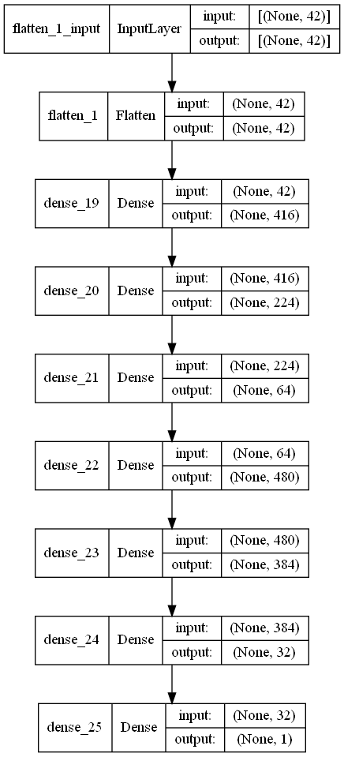

Slide 16
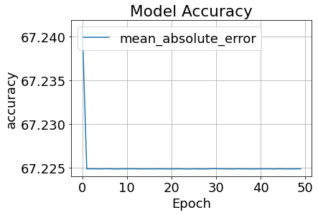
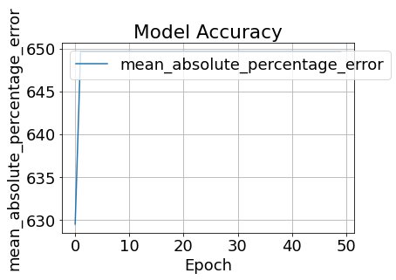
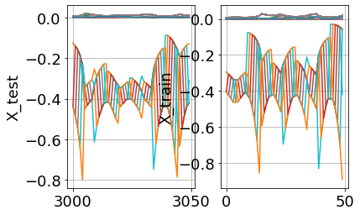
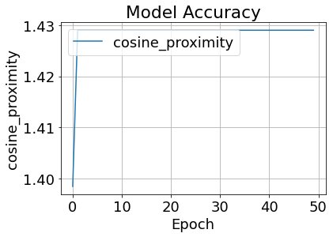
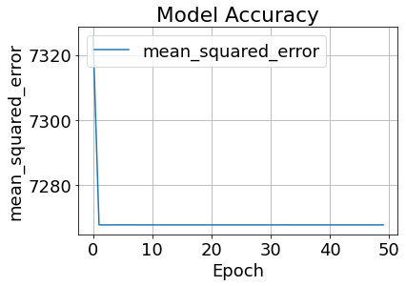
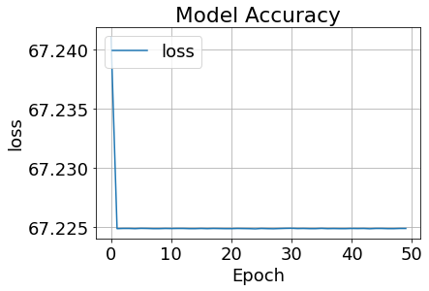
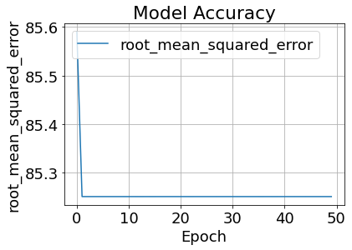

Slide 17
CHANGE OF NARX MODEL NUMBER 3

Slide 18
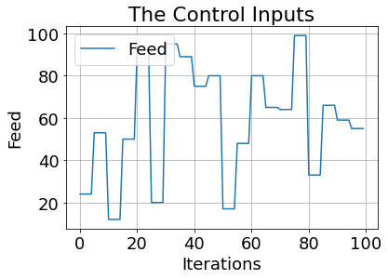
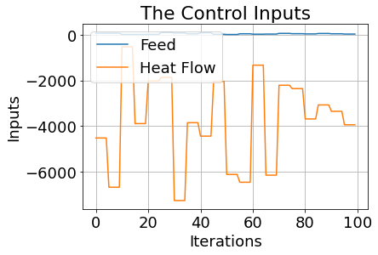
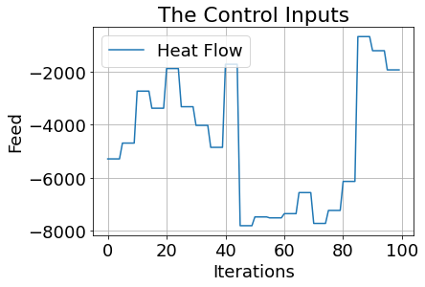
The control inputs are the feed F and the heat flow$\dot{ Q }$:

Slide 19
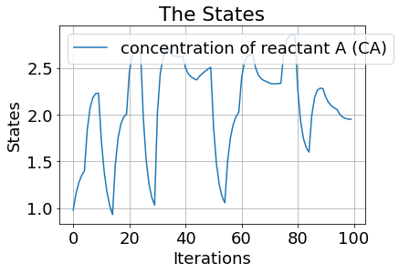
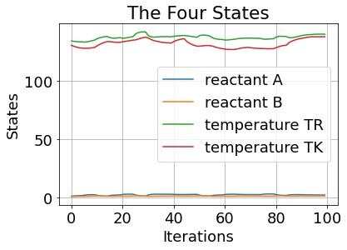
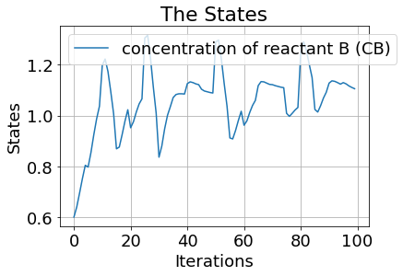
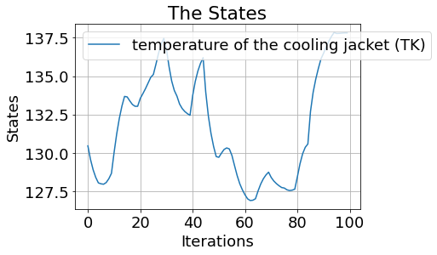
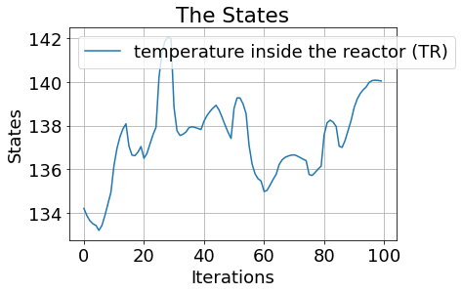
The four states are concentration of reactant A (CA), the concentration of reactant B (CB), the temperature inside the reactor (TR) and the temperature of the cooling jacket (TK):

Slide 20
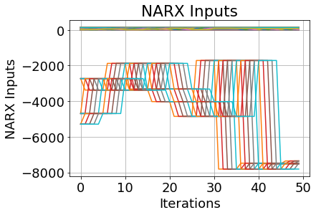
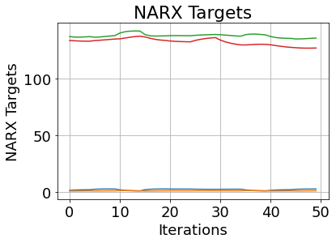
The First NARX Concatenation
nU_delay = int(3)
nY_delay = int(3)
Inputs:
inputs.shape : (3585, 90)
print(inputs):
Targets:
print(targets.shape): (3597, 4)
print(targets):

Slide 21
Results 3:
tuner.results_summary() :
Best mean_absolute_error So Far: 67.18795013427734
Total elapsed time: 00h 05m 50s
Best Tuning Parameters:
History Test
cosine_proximity | 1.4294965267181396
loss | 67.33808898925781
mean_absolute_error | 67.33808898925781
mean_absolute_percentage_error | 111.75189208984375
mean_squared_error | 8885.0146484375
History Train
cosine_proximity | 1.429216980934143
loss | 67.18797302246094
mean_absolute_error | 67.18797302246094
mean_absolute_percentage_error | 113.94412231445312
mean_squared_error | 8842.0732421875

Slide 23
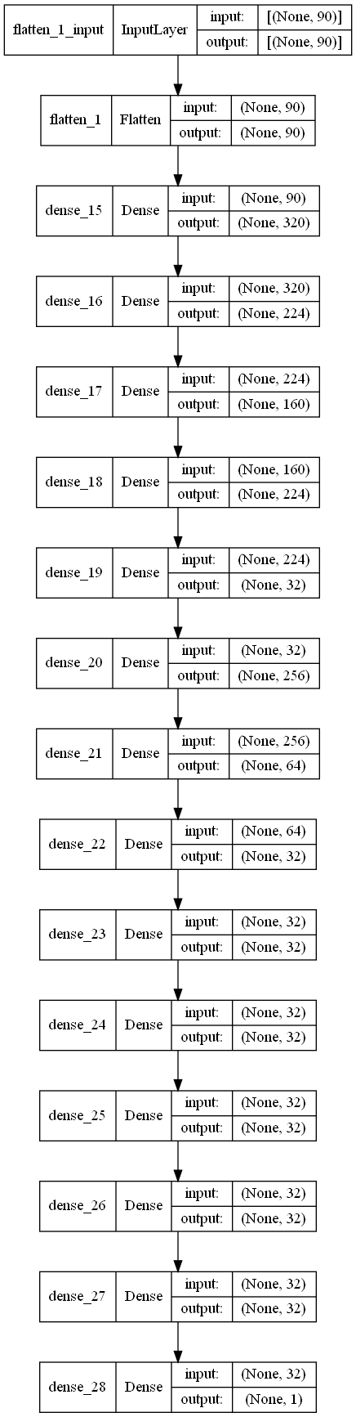

Slide 24
